Slide 1
Discrete Fourier Transform
Slides come from https://www.bilibili.com/video/av44600709
Ying shen
School of software engineering
Tongji university

Slide 2

What does DFT do?
Fourier analysis told us:
Any periodical signal can be expressed as linear combinations of sine and cosine functions
$$x_{1}=cos⁡(2π∗2t)$$
Component1
Frequency: 2HZ
Amplitude: 1
Phase: 0
$$x_{2}=\cos\left(2π∗2t\right)+\cos\left(2π∗5t\right)$$
Component1
Frequency: 2HZ
Amplitude: 1
Phase: 0
Component2
Frequency: 5HZ
Amplitude: 1
Phase: 0
DFT
$$x_{3}=\cos\left(2π∗2t+\frac{π}{3}\right)+2\sin\left(2π∗4t\right)+0.5\cos{(2π∗5t)}$$
Component1
Frequency: 2HZ
Amplitude: 1
Phase: π/3
Component2
Frequency: 4HZ
Amplitude: 2
Phase: 0
Component3
Frequency: 5HZ
Amplitude: 0.5
Phase: 0

Slide 3
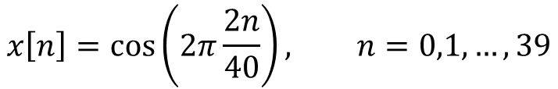
How does DFT calculate those frequency partials?
Sample a cosine wave 40 times within 2 periods
Task: Determine how many times does the cosine wave oscillates in 40 samples?
Human: Counting
Computer: Brute force
$$x\left[n\right]=\cos\left(2π\frac{2n}{40}\right), n=0,1,…,39$$

Slide 4
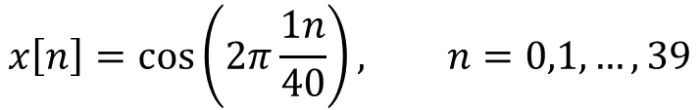
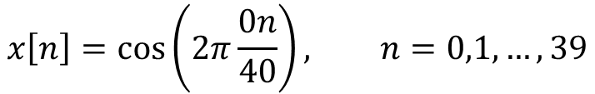
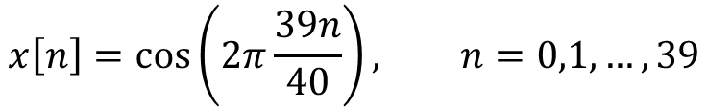
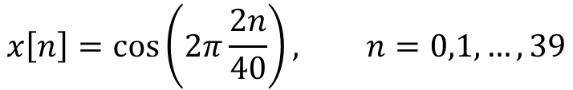
How does DFT calculate those frequency partials?
Choose 40 basis signals:
0 periods
$$x\left[n\right]=\cos\left(2π\frac{0n}{40}\right), n=0,1,…,39$$
1 period
$$x\left[n\right]=\cos\left(2π\frac{1n}{40}\right), n=0,1,…,39$$
2 periods
$$x\left[n\right]=\cos\left(2π\frac{2n}{40}\right), n=0,1,…,39$$
…
…
...
39 periods
$$x\left[n\right]=\cos\left(2π\frac{39n}{40}\right), n=0,1,…,39$$

Slide 5
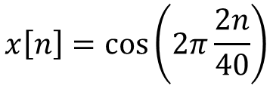

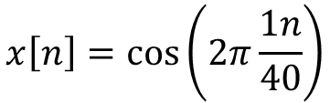
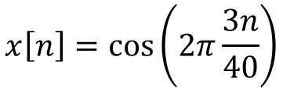
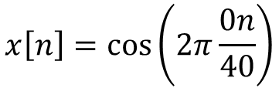

How does DFT calculate those frequency partials?
$$\cos{(2π\frac{2n}{40})}$$
Basic signals
Original signal
$$x\left[n\right]=\cos\left(2π\frac{0n}{40}\right)$$
$$x\left[n\right]=\cos\left(2π\frac{1n}{40}\right)$$
$$x\left[n\right]=\cos\left(2π\frac{2n}{40}\right)$$
Idea: Compare how similar is the original signal to each basis signal
$$x\left[n\right]=\cos\left(2π\frac{3n}{40}\right)$$
$$corr\left(x,y\right)=\sum_{i}{x\left[i\right]y[i]}$$
Correlation function:

Slide 6

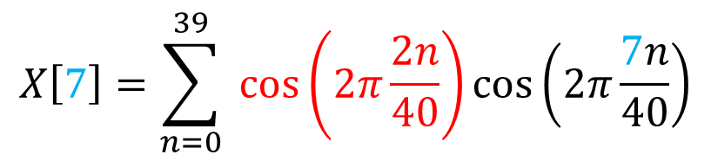
How does DFT calculate those frequency partials?
Correlation between the basis signal containing 7 periods in N samples and the original signal
Original signal
8th basis signal
$$X\left[7\right]=\sum_{n=0}^{39}{ \cos\left(2π\frac{2n}{40}\right)\cos\left(2π\frac{7n}{40}\right)}$$
Calculate $X\left[0\right],X\left[1\right],…,X[39]$

Slide 7

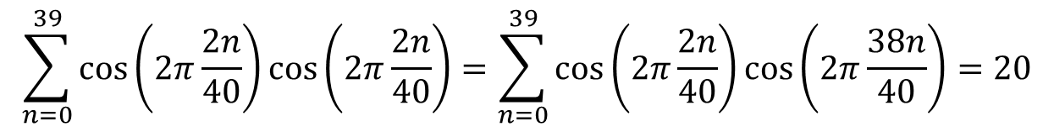
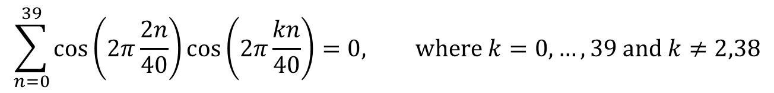
How does DFT calculate those frequency partials?
In this specific example, we found …
For the 2nd and the 38th basis signal, we have
For the other basis signals, we have
$$\sum_{n=0}^{39}{\cos\left(2π\frac{2n}{40}\right)\cos\left(2π\frac{2n}{40}\right)}=\sum_{n=0}^{39}{\cos\left(2π\frac{2n}{40}\right)\cos\left(2π\frac{38n}{40}\right)}=20$$
$$X\left[2\right]=X\left[38\right]=20$$
$$\sum_{n=0}^{39}{\cos\left(2π\frac{2n}{40}\right)\cos\left(2π\frac{kn}{40}\right)}=0, \text{where} k=0,…,39 \text{and} k≠2,38$$
$$X\left[0\right]=X\left[1\right]=X\left[3\right]=…=X\left[37\right]=X[39]=0$$

Slide 8
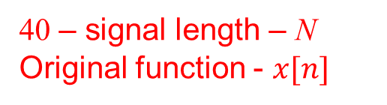
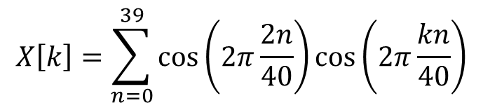
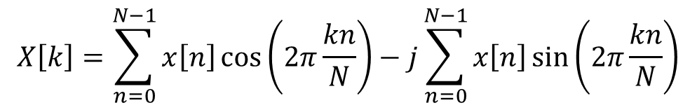

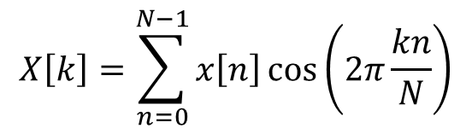
How does DFT calculate those frequency partials?
$$X\left[k\right]=\sum_{n=0}^{39}{\cos\left(2π\frac{2n}{40}\right)\cos\left(2π\frac{kn}{40}\right)}$$
40 – signal length – N
Original function - $x[n]$
General notation
DFT Formula:
$$X\left[k\right]=\sum_{n=0}^{N−1}{x\left[n\right]\cos\left(2π\frac{kn}{N}\right)}$$
$$X\left[k\right]=\sum_{n=0}^{N−1}{x\left[n\right]e^{−2πj\frac{kn}{N}}}$$
$$X\left[k\right]=\sum_{n=0}^{N−1}{x\left[n\right]\cos\left(2π\frac{kn}{N}\right)}−j\sum_{n=0}^{N−1}{x\left[n\right]\sin\left(2π\frac{kn}{N}\right)}$$
Why using complex numbers?

Slide 9
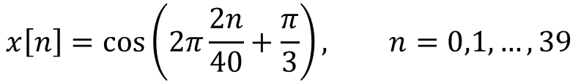
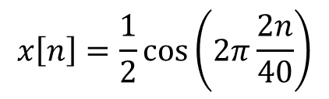
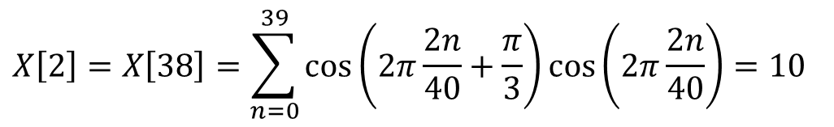
Why complex numbers?
If we only compare the original signal with cosine basis signals, the phase information will be lost
A phase shift example
will generate exactly the same X array
$$x\left[n\right]=\frac{1}{2}\cos\left(2π\frac{2n}{40}\right)$$
$$x\left[n\right]=\cos\left(2π\frac{2n}{40}+\frac{π}{3}\right), n=0,1,…,39$$
$$X\left[2\right]=X\left[38\right]=\sum_{n=0}^{39}{\cos\left(2π\frac{2n}{40}+\frac{π}{3}\right)\cos\left(2π\frac{2n}{40}\right)}=10$$
$$X\left[0\right]=X\left[1\right]=X\left[3\right]=…=X\left[37\right]=X[39]=0$$

Slide 10


Why complex numbers?
Solution: Compare with sine waves to produce another array
Cosine basis
Sine basis
Basis 0
Basis 1
Basis 2
…
…
…
Basis 39
Produce $X_{cos}\left[0\right],…,X_{cos}[39]$
Produce $X_{sin}\left[0\right],…,X_{sin}[39]$

Slide 11
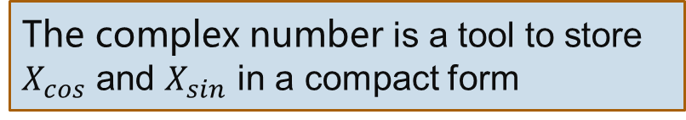
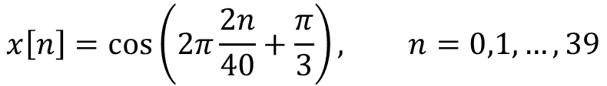

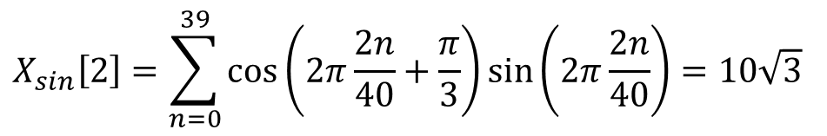
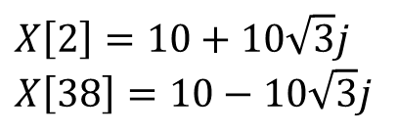
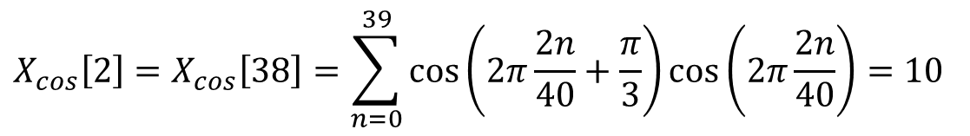
Why complex numbers?
$$x\left[n\right]=\cos\left(2π\frac{2n}{40}+\frac{π}{3}\right), n=0,1,…,39$$
$$X_{sin}\left[2\right]=\sum_{n=0}^{39}{\cos\left(2π\frac{2n}{40}+\frac{π}{3}\right)\sin\left(2π\frac{2n}{40}\right)}=10\sqrt{3}$$
and
$$X_{sin}\left[38\right]=−10\sqrt{3}$$
Recall:
$$X_{cos}\left[2\right]=X_{cos}\left[38\right]=\sum_{n=0}^{39}{\cos\left(2π\frac{2n}{40}+\frac{π}{3}\right)\cos\left(2π\frac{2n}{40}\right)}=10$$
$$X\left[2\right]=10+10\sqrt{3}j$$
$$X\left[38\right]=10−10\sqrt{3}j$$
The complex number is a tool to store $X_{cos}$ and $X_{sin}$ in a compact form

Slide 12

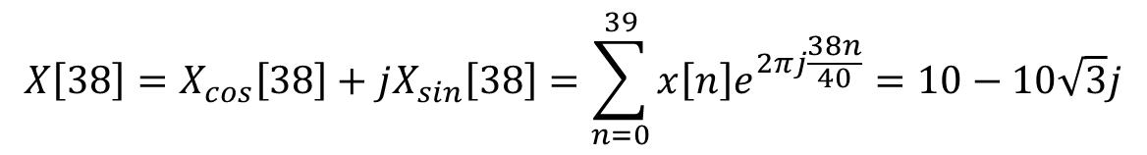

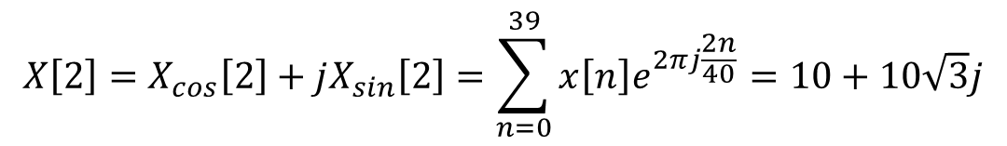


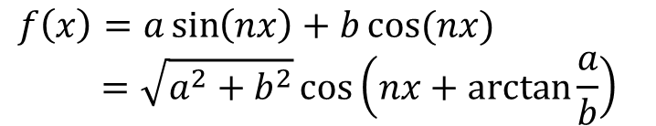
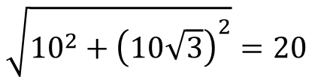

Why complex numbers?
Compound form
Magnitude:
Phase:
$$X\left[2\right]=X_{cos}\left[2\right]+jX_{sin}\left[2\right]=\sum_{n=0}^{39}{x\left[n\right]e^{2πj\frac{2n}{40}}}=10+10\sqrt{3}j$$
$$X\left[38\right]=X_{cos}\left[38\right]+jX_{sin}\left[38\right]=\sum_{n=0}^{39}{x\left[n\right]e^{2πj\frac{38n}{40}}}=10−10\sqrt{3}j$$
$$\sqrt{{10}^{2}+{\left(10\sqrt{3}\right)}^{2}}=20$$
Math behind
$$sin⁡(nx)$$
$$\arctan{\frac{10\sqrt{3}}{10}}=\frac{π}{3}$$
$$f\left(x\right)=a\sin\left(nx\right)+b\cos{(nx)}$$
$$=\sqrt{a^{2}+b^{2}}\cos\left(nx+\arctan{\frac{a}{b}}\right)$$
We won’t loose information anymore!
$$a$$
$$b$$
$$cos⁡(nx)$$

Slide 13
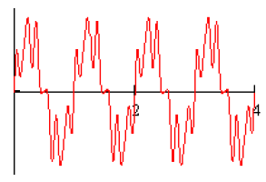
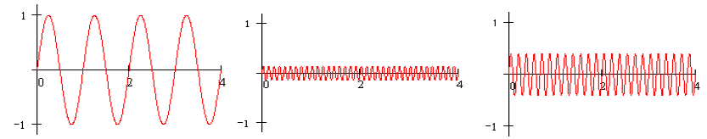
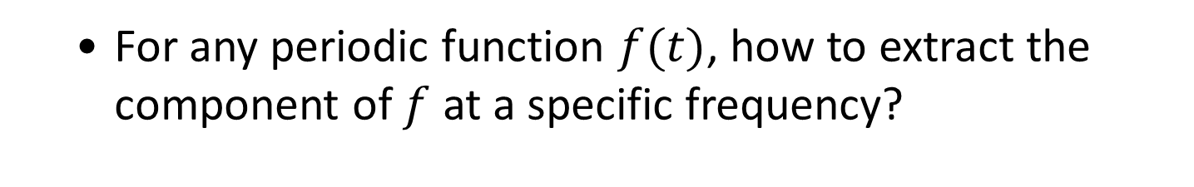
Fourier Series
For any periodic function $f(t)$, how to extract the component of $f$ at a specific frequency?
is composed of the following components

Slide 14
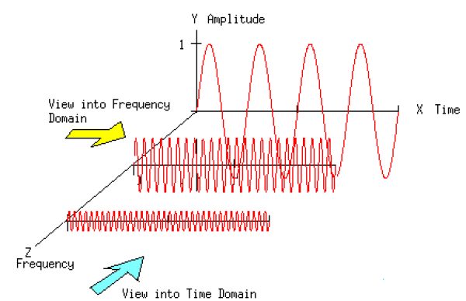

Fourier Series
For any periodic function $f(t)$, how to extract the component of $f$ at a specific frequency?

Slide 15
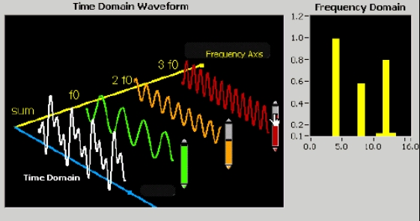
Fourier Series
For any periodic function $f(t)$, how to extract the component of $f$ at a specific frequency?

Slide 16

Fourier Transforms
Fourier transform of $f(t)$ (maybe is not periodic) is defined as
Inverse Fourier transform
How to get these formulas?
Let’s start the story from Fourier series to Fourier transform…

Slide 17
Fourier Series
For any periodic function $f(t)$, how to extract the component of $f$ at a specific frequency?
Fourier Series Any periodic function can be expressed as a sum of sines and cosines of different frequencies each multiplied by a different coefficient
more details

Slide 18
Fourier Series
For a periodic function $f(t)$, with period $T$
Fourier Series
where
Redundant!
,

Slide 19
From Fourier Series to Fourier Transforms
According to Euler formula
Easy to have
Then, Fourier series become

Slide 20
From Fourier Series to Fourier Transforms
According to Euler formula
Easy to have
Then, Fourier series become
Then, let
Then,

Slide 21
From Fourier Series to Fourier Transforms
We can see that
Thus,

Slide 22

From Fourier Series to Fourier Transforms
,where $C_{n}$ is defined by (2)
This is the Fourier series in complex form
How about a non-periodic function?

Slide 23
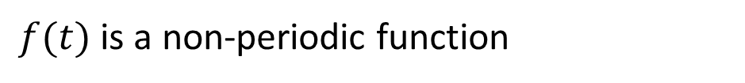

From Fourier Series to Fourier Transforms
$f(t)$ is a non-periodic function
We make a new function $f_{T}(t)$ which is periodic and the period is $T$
If , $f_{T}(t)$ becomes $f\left(t\right)$
According to Fourier series
Let

Slide 24
From Fourier Series to Fourier Transforms
when

Slide 25
From Fourier Series to Fourier Transforms
when
,
,
Denote by
Fourier transform
Inverse Fourier transform

Slide 26

From Fourier Series to Fourier Transforms
$s$ here actually is the angular frequency
In the signal processing domain, we usually use another form by substituting s by , where is the frequency (measured by Herz)

Slide 27
Discrete Fourier Transform (DFT) in 1D Case
Given a discrete sequence with M points
Regard it as a periodic signal, thus its basis frequency is
For its frequency components, the frequencies are,
Its DFT is computed as
Usually, we write it as,

Slide 28

Discrete Fourier Transform (DFT) in 1D Case
Thus, $f$’s DFT also has M points
and
IDFT
For DFT, there is a fast algorithm for computation, FFT (Fast Fourier Transform)

